Slide 1
Straight to the Sphere
making maps with kids
Erik MacIntosh - NOAA Silver Spring

Slide 2
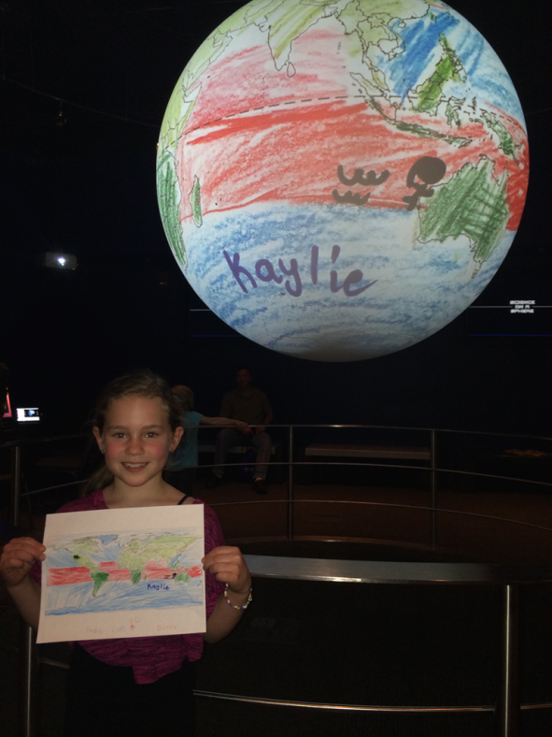
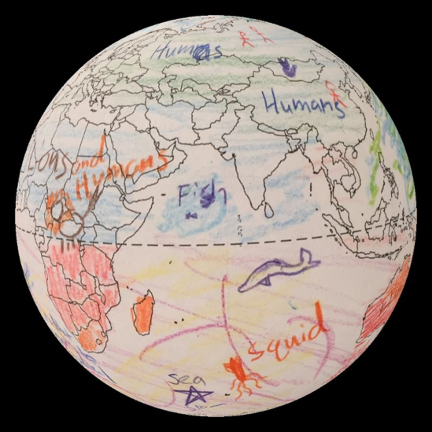
Kid-generated SOS datasets

Slide 3
Getting Started
Everything you need is provided in a .zip file. Just extract it into the site-custom folder on your computer.
Print copies of the blank map - it helps to print on cardstock
Set up stations for participants to color their maps - colored pencils seem to work better than crayons
Designate an area to photograph/scan completed maps - use flash
Notes:
Make sure to have pencil sharpeners

Slide 4
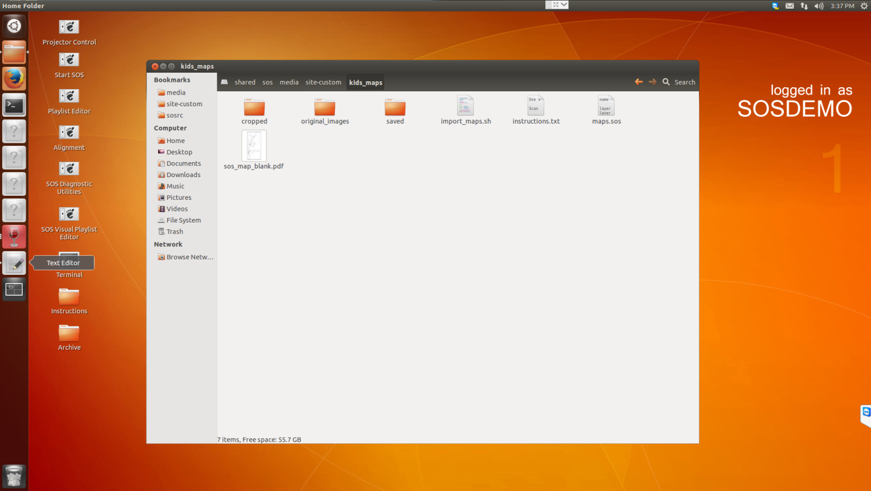
Notes:
Copy your images directly from camera or scanner to “original_images”
It can be helpful to copy images from “cropped” to “saved” when you finish with one group/batch so there are fewer images to display

Slide 5
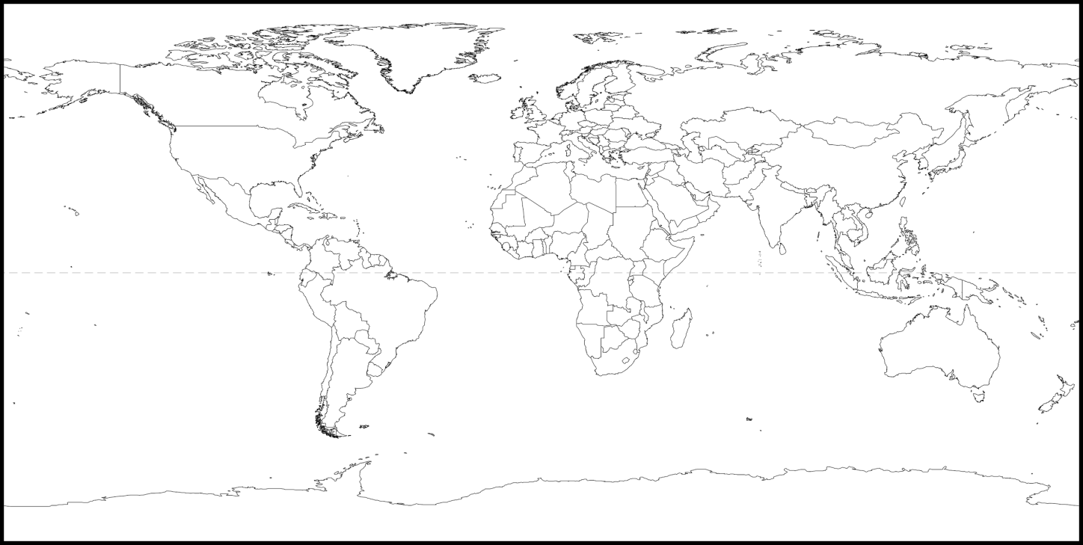
Notes:
It is important that all drawing should be inside the black border surrounding the map. Text or drawings outside the border will prevent the computer from automatically cropping the image.
Text or other symbols/drawings should be done closer to the equator to minimize distortion
If a spot for a name or logo is desired, placing in Antarctica is recommended, as that area is hidden by the “black hole”

Slide 6
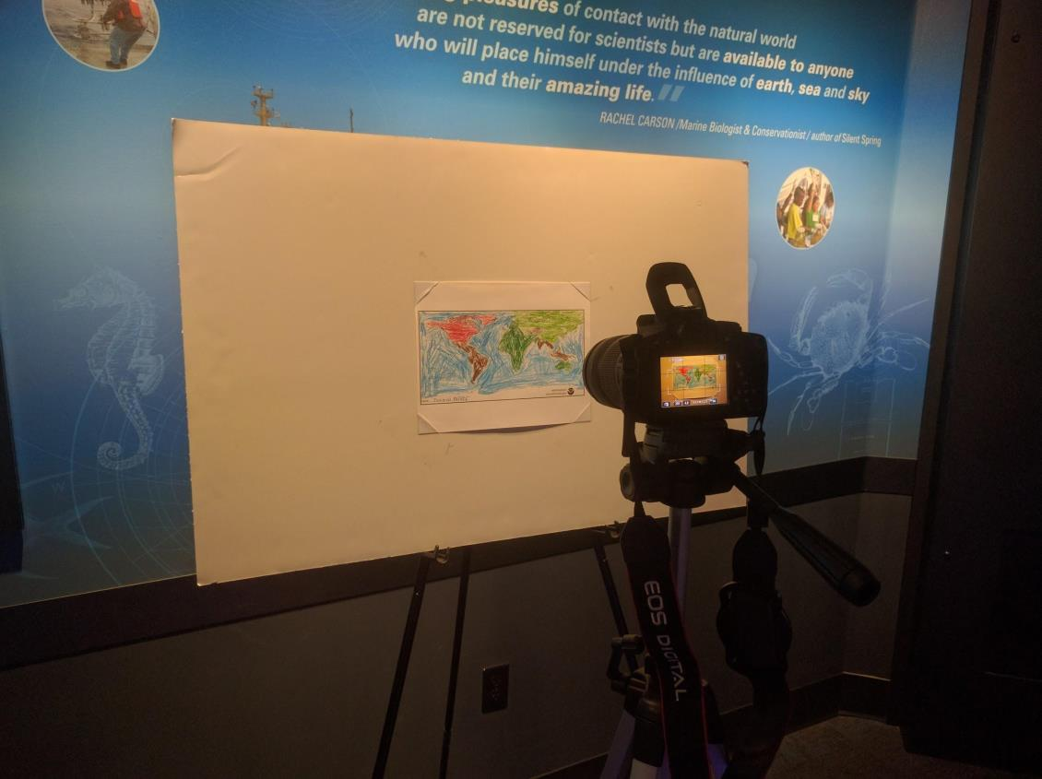
Notes:
Photograph the completed maps against a white background. One method that has been effective is to use a white foam board with white or clear photo-corners on one tripod with a camera positioned on another tripod to allow for efficient workflow. The image should be as level as possible and the field of view should be restricted to the white background. Use flash to even out lighting.

Slide 7
Putting the maps on the sphere
Copy all the maps from the camera (or scanner) into the “original_images” folder
Run the script - double-click and select “run in terminal”
Verify the images in “cropped” folder are adequate
Open or reload maps.sos

Slide 8
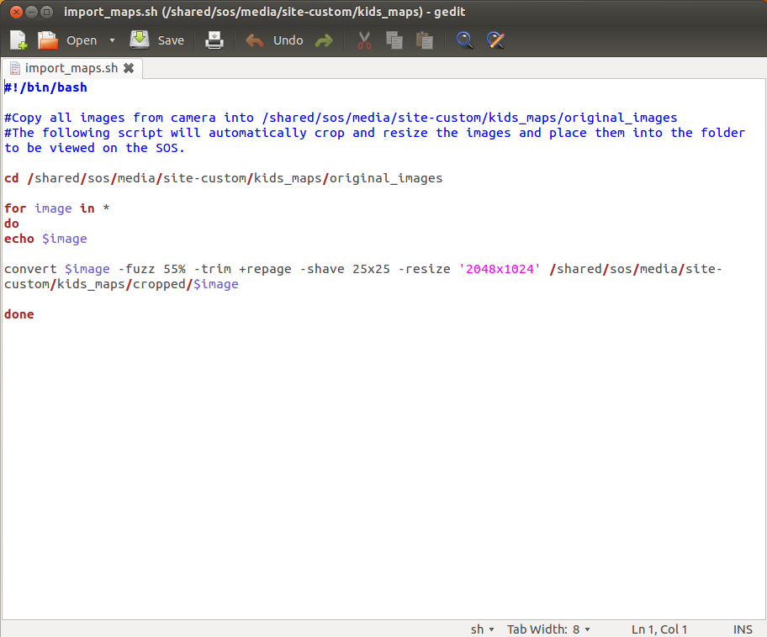
Notes:
If you receive any errors, you may need to open import_maps.sh (double-click and "display") then adjust the number after "-fuzz" Generally, this value should be around 45-65%.
If you notice that you are still seeing borders on all sides, you can increase the number after "-shave" This is the total number of pixels that are removed from each edge of the image after autocropping to the black line.

Slide 9
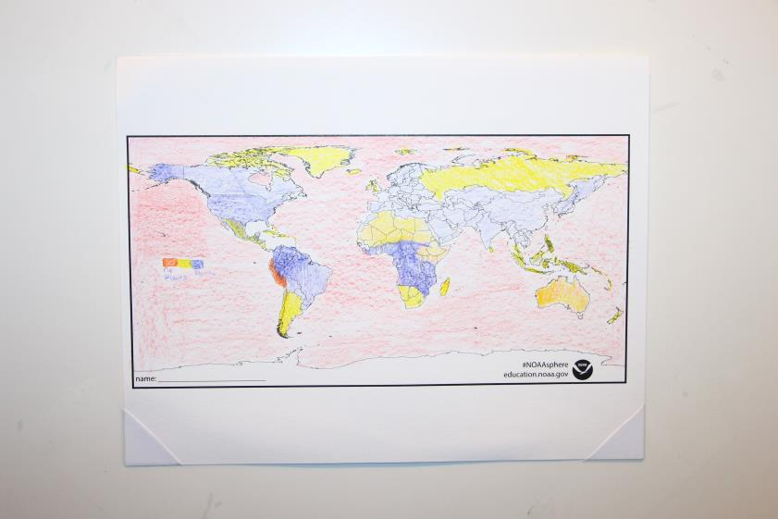
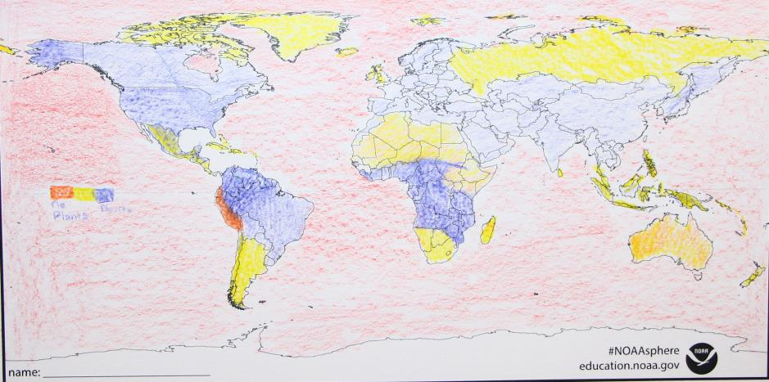
Notes:
Verify that the images in the "cropped" folder are all satisfactory. You may now delete the images from "original_images" to make room for the next batch.

Slide 10
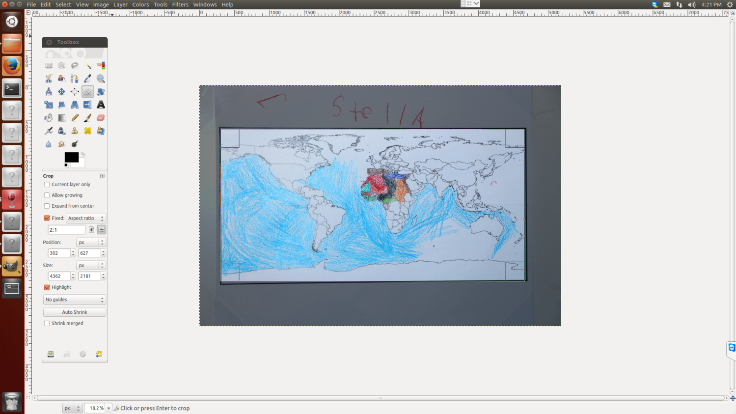
Notes:
Sometimes you get a really stubborn image - you may need to use GIMP to manually crop - use the crop tool with a fixed 2:1 aspect ratio.

Slide 11
