Slide 1
El Niño & La Niña related changes in climate and weather have many impacts on the landscape and the economy. For instance, droughts and floods can make farming very difficult. This can lead to food shortages and increased prices.
Queensland, Australia flooding during La Niña in 2011
Riverina, Australia drought in 2007
Image source: Wikipedia, Virtual Steve
http://en.wikipedia.org/wiki/File:Riverina_Sheep_%28during_drought%29.jpg
Image source: Timothy Swanson
https://www.flickr.com/photos/kingbob86/5341730273/

Slide 2
Daily River Discharge 1988-1989
This animation shows daily river discharge during 1988 & 1989
El Niño occurred during the first six months of 1988
La Niña was strong from January-November 1989
River discharge is dependent on the day-to-day weather
Not all of the typical El Niño & La Niña trends appear in this dataset because it only represents a short period of time
Typical El Niño & La Niña climate patterns were determined by averaging many years of weather data

Slide 3
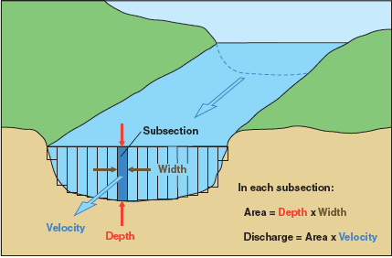
The ocean’s surface temperature impacts precipitation, which affects the amount of water that flows down rivers and into ocean. This is called river discharge. The diagram below explains how river discharge is calculated. It is commonly measured in cubic meters per second.
Image source: Department of the Interior, U.S. Geological Survey

