Slide 1
🌎 Data Lens: Exploring Earth’s Visual Stories
We are going to slow down and take ten minutes or so to just observe and discuss what we discover and notice. There are no right or wrong answers.
First: Ground Rules
Raise your hand to share your ideas with the class.
All ideas are welcome.
Be respectful of others’ ideas. It’s okay to disagree.
Build on each other’s ideas.
Next: One minute to quietly observe…

Slide 2
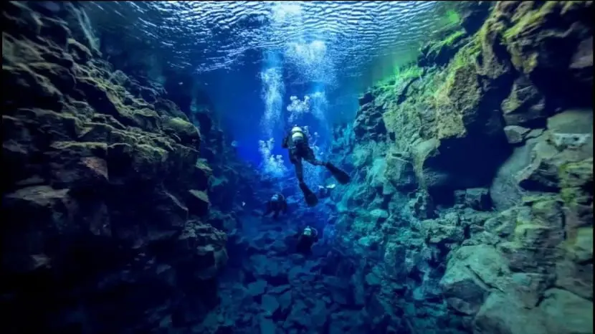
What’s going on here?
Notes:
Q1 – “What is going on in this image?”; after an observation is made, paraphrase and maybe follow up with Q2.
Q2 – “What do you see that makes you say that?; paraphrase again and to obtain the next observation use Q3.
Q3 – “What more can we find?”; this is an opening for another student to share an observation.
Photo Credit: German Portillo

Slide 3
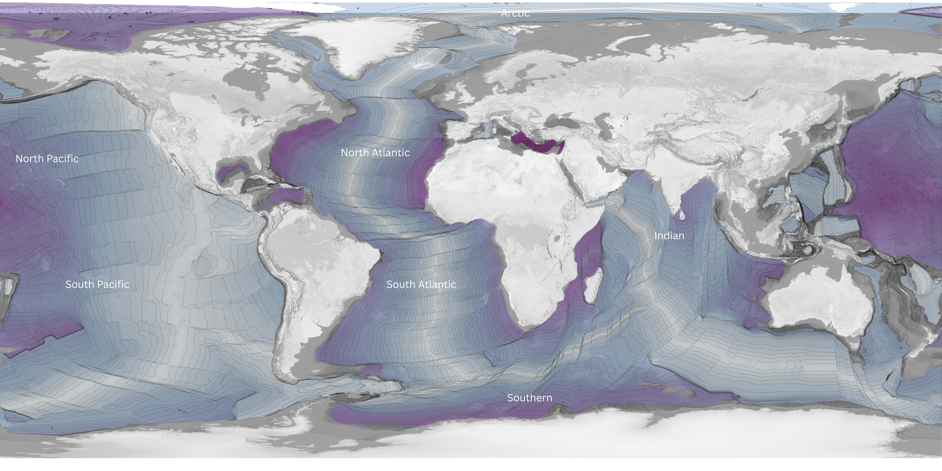
What’s going on here?
Notes:
Q1 – “What is going on in this image?”; after an observation is made, paraphrase and maybe follow up with Q2.
Q2 – “What do you see that makes you say that?; paraphrase again and to obtain the next observation use Q3.
Q3 – “What more can we find?”; this is an opening for another student to share an observation.

Slide 4
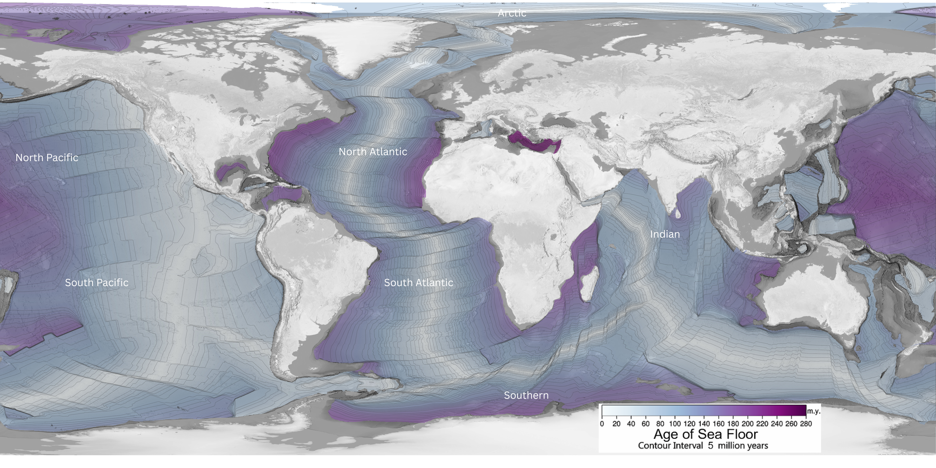
Now, what do you notice?
Notes:
Q1 – “What is going on in this image?”; after an observation is made, paraphrase and maybe follow up with Q2.
Q2 – “What do you see that makes you say that?; paraphrase again and to obtain the next observation use Q3.
Q3 – “What more can we find?”; this is an opening for another student to share an observation.

Slide 5
Questions
Answer on your worksheet:
What patterns do you notice?
What was one observation that a classmate made that made you think differently about the map?

Slide 6
End of Data Lens
Learn more about the dataset. Read the descriptions on the next slide. (5 min)
Then, read about Ocean floor features and summarize what you thought was most interesting from the reading. (15-20 min)

Slide 7
Age of the Seafloor
The surface of the Earth is composed of a mosaic of tectonic plates with edges that create fault lines. The Earth's crust is made of seven major plates and several smaller plates. As the plates move, new sea floor can be created. The plates form three different kinds of boundaries: convergent, divergent, and transform. Convergent boundaries are also called collision boundaries because they are areas where two plates collide. At transform boundaries, the plates slide and grind past one another. The divergent boundaries are the areas where plates are moving apart from one another. Where plates move apart, new crustal material is formed from molten magma from below the Earth's surface. Because of this, the youngest sea floor can be found along divergent boundaries, such as the Mid-Atlantic Ocean Ridge. The spreading, however, is generally not uniform causing linear features perpendicular to the divergent boundaries, shown in this dataset as contour lines.
This dataset shows the age of the ocean floor with the lines or contours of 5 million years as shown in the colorbar. Plate names and plate boundaries are available as layers but must be turned on to appear. The data is from four companion digital models of the age, age uncertainty, spreading rates and spreading asymmetries of the world's ocean basins. Scientists use the magnetic polarity of the sea floor to determine the age. Very little of the sea floor is older than 150 million years. This is because the oldest sea floor is subducted under other plates and replaces by new surfaces. The tectonic plates are constantly in motion and new surfaces are always being created. This continual motion is evidenced by the occurrence of earthquakes and volcanoes.

Slide 8
Reading extension
Intended for: 6-12 Grade (15-20 minutes)
Reading Extension: NOAA Education – Ocean floor features
Summarize THE MOST INTERESTING PART in ~30 words.
Present your summary to the class.

