Slide 1
🌎 Data Lens: Exploring Earth’s Visual Stories
We are going to slow down and take ten minutes or so to observe a map and discuss what we discover and notice about it. There are no right or wrong answers.
First: Ground Rules
Raise your hand to share your ideas with the class.
All ideas are welcome.
Be respectful of others’ ideas
It’s okay if you disagree
Build off each other’s ideas
Next: One minute to quietly observe…

Slide 2
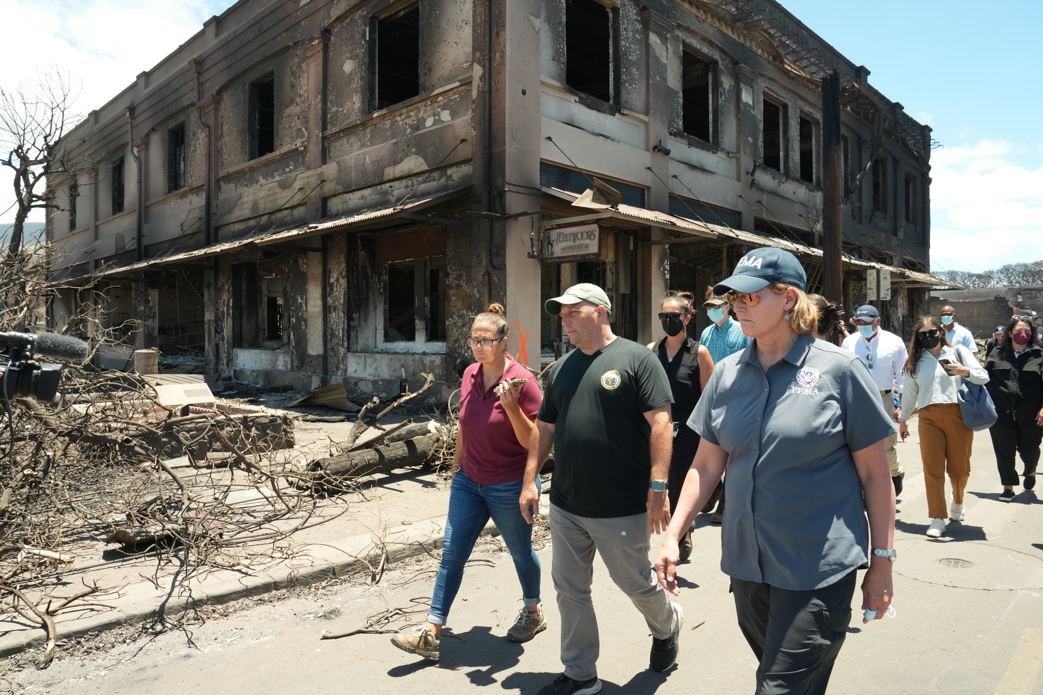
What’s going on here?
Notes:
Q1 – “What is going on in this image?”; after an observation is made, paraphrase and maybe follow up with Q2.
Q2 – “What do you see that makes you say that?; paraphrase again and to obtain the next observation use Q3.
Q3 – “What more can we find?”; this is an opening for another student to share an observation.

Slide 3
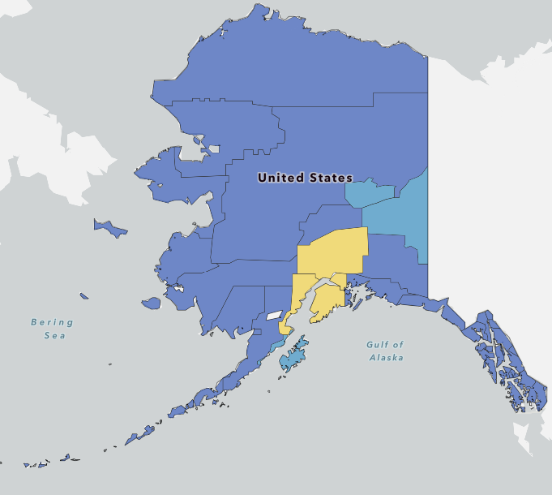
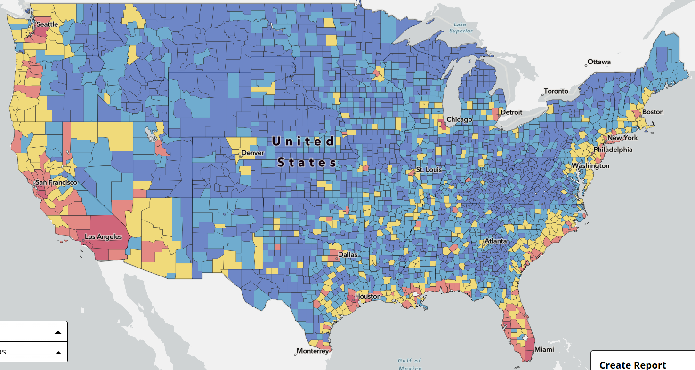
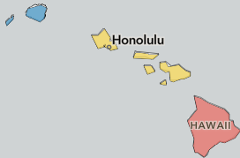
What’s going on here?
Notes:
Q1 – “What is going on in this image?”; after an observation is made, paraphrase and maybe follow up with Q2.
Q2 – “What do you see that makes you say that?; paraphrase again and to obtain the next observation use Q3.
Q3 – “What more can we find?”; this is an opening for another student to share an observation.

Slide 4
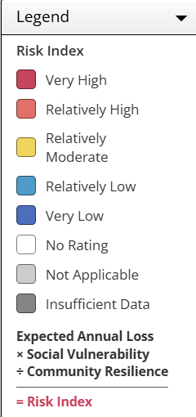
Now, what do you notice?
Notes:
Q1 – “What is going on in this image?”; after an observation is made, paraphrase and maybe follow up with Q2.
Q2 – “What do you see that makes you say that?; paraphrase again and to obtain the next observation use Q3.
Q3 – “What more can we find?”; this is an opening for another student to share an observation.

Slide 5
Questions
Answer on your worksheet:
What patterns do you notice?
What do you think are the reasons some areas are higher “risk” than other areas?
What was one observation that a classmate made that made you think differently about the map?

Slide 6
End of Data Lens
Learn more about the dataset. Read the descriptions on the next slide. (5 min)
Then, complete the optional “Deeper exploration extension.” Grades 8-12+ (10-20 min)

Slide 7
National Risk Index
The National Risk Index is a dataset and online tool to help illustrate the United States communities most at risk for 18 natural hazards. It was designed and built by FEMA in close collaboration with various partners in academia; local, state and federal government; and private industry.
The 18 natural hazards included in the National Risk Index are:
Avalanche, Coastal Flooding, Cold Wave, Drought, Earthquake, Hail, Heat Wave, Hurricane, Ice Storm, Landslide, Lightning, Riverine Flooding, Strong Wind, Tornado, Tsunami, Volcanic Activity, Wildfire, Winter Weather
Source: Federal Emergency Management Agency (FEMA)

Slide 8
Photo Credit: Wikipedia Commons License
FEMA, US Fire Administration and partners tour Hawaii fire damage. Remains of Mick Fleetwood's nightclub, "Fleetwood's on Front St.", Front Street, Lahaina, Hawaii. Governor Josh Green walks in the center.
Photo by By: Dominick Del Vecchio

Slide 9
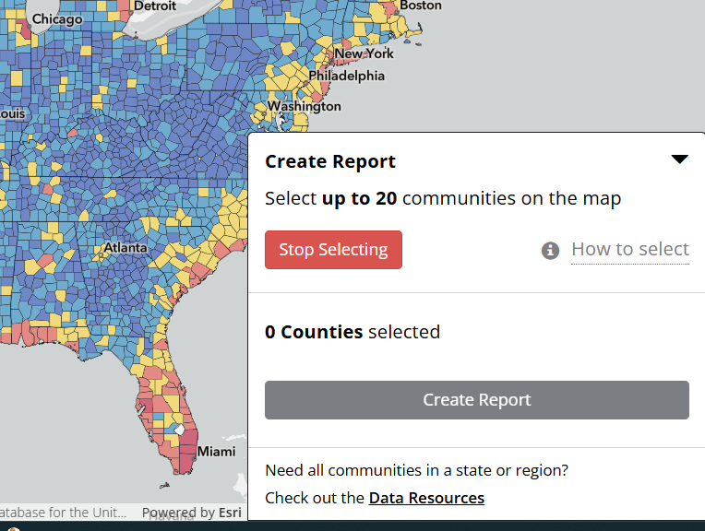
Deeper exploration extension instructions
Intended for: 8-12+ Grade (20 minutes)
Go to the FEMA National Risk Index map, click up-arrow Create Report, then choose a county and click Create Report button.
1. What U.S. County in which State did you choose?
2. What natural hazards are most at risk in the county?
3. What surprises you about the information you gained?
Then, select two counties in the U.S. One that is close to you and one that is far away, click Create a Comparison Report.
Summarize the information in your report to the class.

