Slide 1
🌎 Data Lens: Exploring Earth’s Visual Stories
We are going to slow down and take ten minutes or so to observe a map and discuss what we discover and notice about it. There are no right or wrong answers.
First: Ground Rules
Raise your hand to share your ideas with the class.
All ideas are welcome.
Be respectful of other’s ideas
  It’s okay if you disagree
  Build off each other’s ideas
Next: One minute to quietly observe…

Slide 2
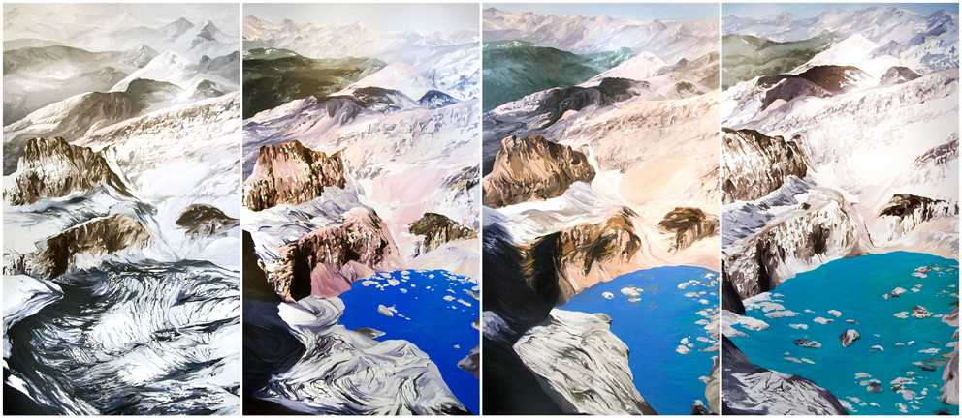
What’s going on here?
Diane Burko; Grinnell Mt. Gould Quadtych
National Climate Assessment 5; Art x Climate

Slide 3
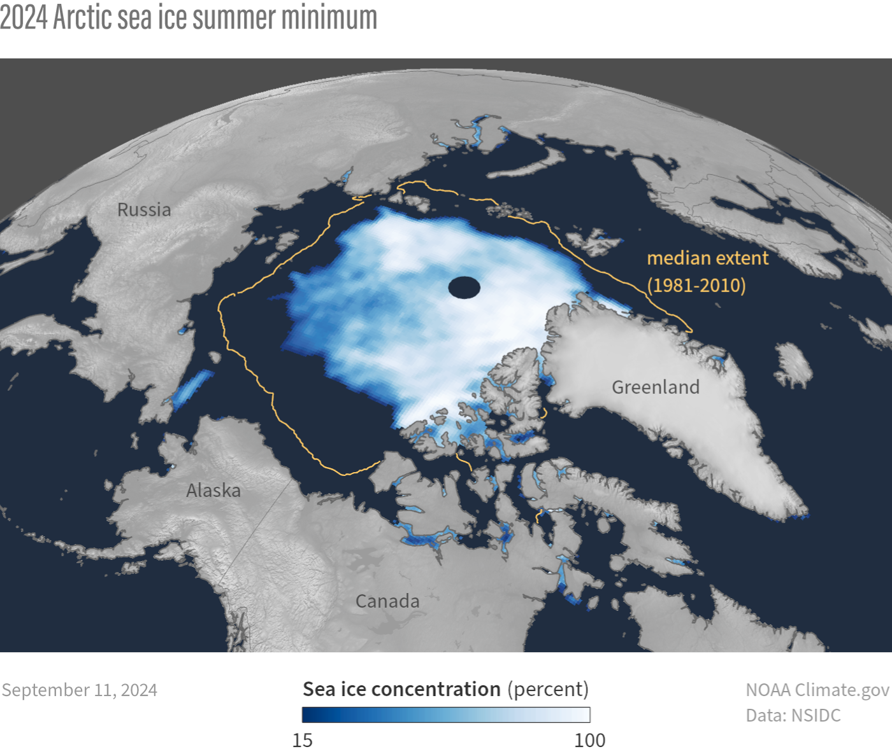
1) What’s going on in this image?
Notes:
Q1 – “What is going on in this image?”; after an observation is made, paraphrase and maybe follow up with Q2.
Q2 – “What do you see that makes you say that?; paraphrase again and to obtain the next observation use Q3.
Q3 – “What more can we find?”; this is an opening for another student to share an observation.

Slide 4
Answer on your worksheet:
Grinnell Mt. Gould Quadtych
Glacier
What do these two images have in common?
In what ways do these images differ?
What do you think the timelapse of the glacier is trying to convey?
What do you think the snapshot of Arctic Sea Ice minimum is trying to convey?
2024 – Arctic sea ice minimum

Slide 5
End of Data Lens
Learn more about the dataset and the artwork. Read the descriptions on the next two slides. (5 min)
Then, read an article and summarize it in 30 words. (20 min)

Slide 6
2024 Arctic sea ice summer minimum
Sea ice concentration in the Arctic Ocean on September 11, 2024, the day of the smallest minimum ice extent of the year. The gold line shows the median extent of ice from 1981-2020, meaning half of the years had larger extents on this day, and half had smaller. The ice extent—the area of ocean at least 15% covered by ice—in 2024 was seventh smallest on record. NOAA Climate.gov image, based on data from the National Snow and Ice Data Center.
Source: National Snow and Ice Data Center

Slide 7
Diane Burko
Grinnell Mt. Gould Quadtych
(2009, oil on canvas)
Artist's statement: This work portrays Grinnell Glacier in Glacier National Park, Montana in four time periods between 1920 and 2006, with the glacier losing mass in each painting. The piece considers the marks that humanity leaves on the landscape, reflecting the impact of industrial and colonial activity on those same landscapes. While these paintings deal with impending climate catastrophe, rather than lingering in dystopia they celebrate the sublimity of the landscape by honoring the intricate geological and political webs that shape the identity of a place.
Source: Fifth National Climate Assessment Art x Climate Gallery

Slide 8
Reading Extension
High School level (10-20 minutes)
Reading Extension: What’s the coldest the Earth’s ever been?
Summarize the article in ~30 words. Present your summary to the class.

