Slide 1
🌎 Data Lens: Exploring Earth’s Visual Stories
We are going to slow down and take ten minutes or so to observe a map and discuss what we discover and notice about it. There are no right or wrong answers.
First: Ground Rules
Raise your hand to share your ideas with the class.
All ideas are welcome.
Be respectful of other’s ideas
  It’s okay if you disagree
  Build off each other’s ideas
Next: One minute to quietly observe…

Slide 2
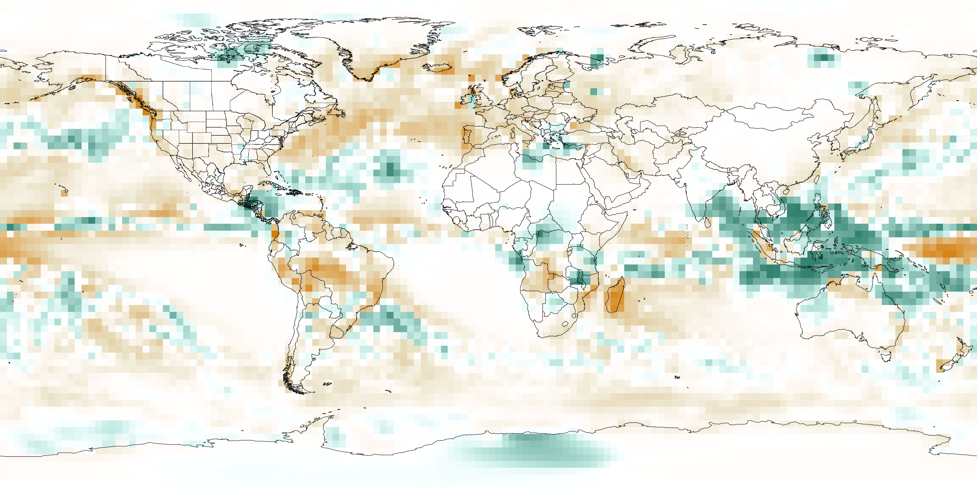
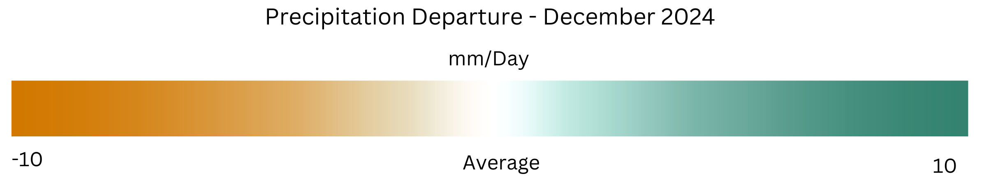
What do you notice here?
Notes:
Q1 – “What is going on in this image?”; after an observation is made, paraphrase and maybe follow up with Q2.
Q2 – “What do you see that makes you say that?; paraphrase again and to obtain the next observation use Q3.
Q3 – “What more can we find?”; this is an opening for another student to share an observation.

Slide 3
Precipitation Departure from Average – December 2023
Notes:
Q1 – “What is going on in this image?”; after an observation is made, paraphrase and maybe follow up with Q2.
Q2 – “What do you see that makes you say that?; paraphrase again and to obtain the next observation use Q3.
Q3 – “What more can we find?”; this is an opening for another student to share an observation.

Slide 4
Student 1 – Focus on Figure 1
Student 2 – Focus on Figure 2
6 minutes: Answer questions #2-3 about the Figure on your worksheet.
6 minutes: Pair up with your partner. Discuss and answer #4-5.
Pair Jigsaw Extension - Split students into pairs

Slide 5
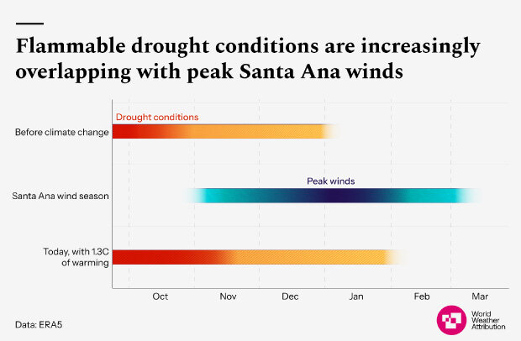
Student 1 – Figure 1
3. Write a few sentences that explain what you notice in the figure.
4. What surprises you, confuses you or what do you not understand about the information in the figure?
5. Write one sentence about the figure that your partner described to you.
6. How do these figures relate to the map that you looked at as a class, Precipitation Departure from Average – December 2023?

Slide 6
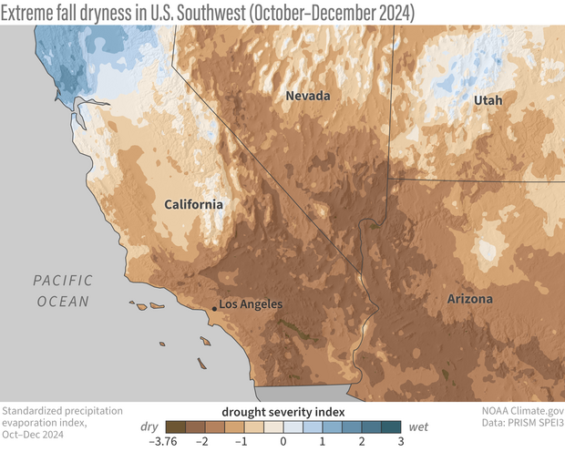
Student 2 – Figure 2
3. Write a few sentences that explain what you notice in the figure.
4. What surprises you, confuses you or what do you not understand about the information in the figure?
5. Write one sentence about the figure that your partner described to you.
6. How do these figures relate to the map that you looked at as a class, Precipitation Departure from Average – December 2023?

Slide 7
End of Data Lens
Want to learn more about Precipitation Departure mapped dataset and the figures that you used? Read next two slides for brief detailed descriptions.
Optional High School reading extension on final slide.

Slide 8
“The weather and climate influences on the January 2025 fires around Los Angeles”
Highlights
A trifecta of fire-friendly climate conditions set the stage for the January 2025 fires: back-to-back wet winters that boosted vegetation, a record-dry fall, and an extremely strong Santa Ana wind event.
By one estimate, record-low fall precipitation had a bigger influence on the exceptionally low vegetation moisture than the near-record summer and fall temperatures.
A preliminary attribution analysis concluded that long-term global warming and the development of La Niña contributed roughly equally to making the extreme fire weather conditions more likely and more extreme.
The most effective near-term strategies to lower risk are controlling unwanted human ignitions under high-risk conditions, using fire-resistant building materials and landscaping, and locating development in lower-risk areas.
Source – Climate.gov

Slide 9
Precipitation Departure
Weather patterns change all the time, but big climate cycles like El Niño and La Niña can make some places much wetter or drier than usual. Scientists compare current rainfall to past averages to see these patterns more clearly.
This map uses data from the Global Precipitation Climatology Project, where experts at NOAA and NASA combine information from many satellites to measure rainfall around the world. It takes a few months to check the data and compare it with ground measurements to make sure it's accurate.
- Green areas show places where more rain fell than usual (compared to 1981–2010).
- Orange areas show places with less rain than normal.
By studying these maps, scientists can track global rainfall changes and understand how climate cycles affect different regions! 🌎💧
Credit: NOAA

Slide 10
Reading Extension – High School
Choose an article to read on NOAA’s Featured wildfires https://www.noaa.gov/content/wildfires
Summarize the article in ~30 words. Present your summary to the class.

