Slide 1
🌎 Data Lens: Exploring Earth’s Visual Stories
We are going to slow down and take ten minutes or so to observe a map and discuss what we discover and notice about it. There are no right or wrong answers!
First: Ground Rules
Raise your hand to share your ideas with the class.
All ideas are welcome.
Be respectful of others’ ideas!
It’s okay if you disagree!
Build off each others’ ideas.
Next: One minute to quietly observe…

Slide 2
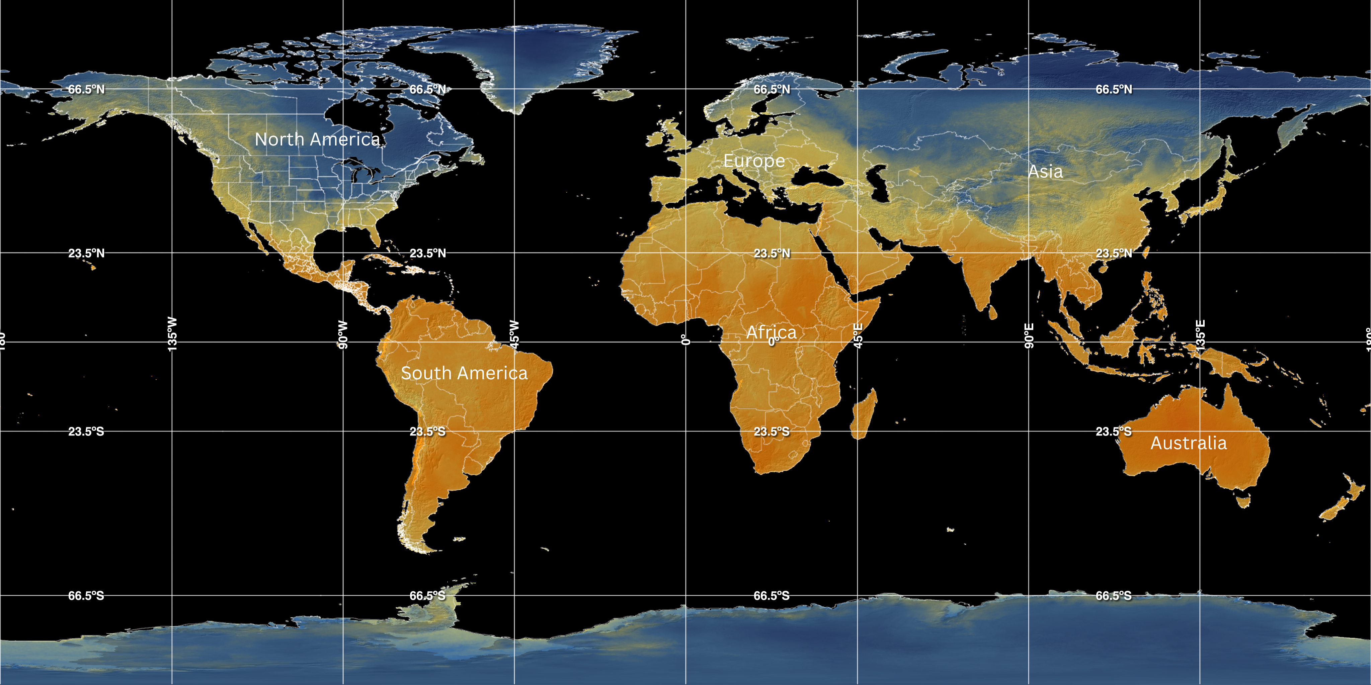
What do you notice here?

Slide 3
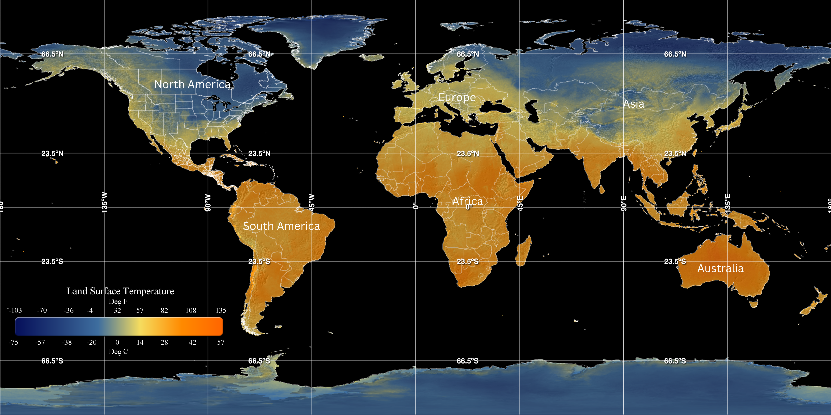
1) What’s going on in this image?
Land Surface Temperature – 1/22/2025
Notes:
Q1 – “What is going on in this image?”; after an observation is made, paraphrase and maybe follow up with Q2.
Q2 – “What do you see that makes you say that?; paraphrase again and to obtain the next observation use Q3.
Q3 – “What more can we find?”; this is an opening for another student to share an observation.

Slide 4
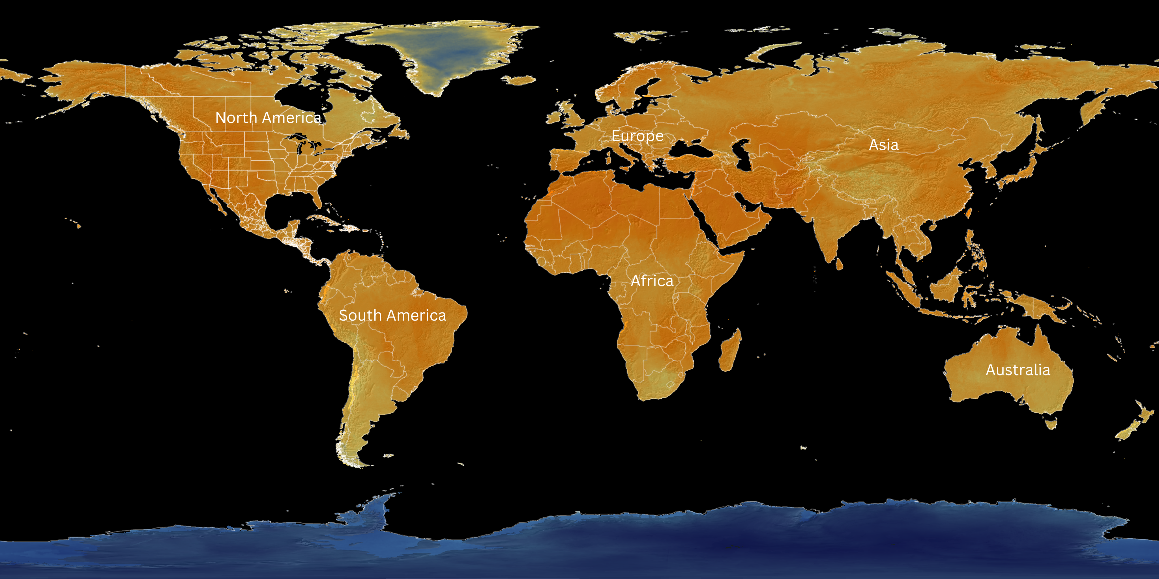
Complete the Venn diagram on your worksheet with similarities and differences between the two maps
If the second map is the hottest day of 2024, what day do you guess that might have been?
Is there anything that surprises you about either of the maps?
January 22, 2025
Hottest Day of 2024

Slide 5
4) What was one comment that a classmate made that changed your thinking about the map observation?
Last Question to answer on your sheet

Slide 6
End of Data Lens
Want to learn more about the dataset? (5 min)
Read the dataset description on the next slide. Jot down any words you don’t understand.
Want to learn a little more about climate zones? (10 min)
Do a brief partner jigsaw read and share.

Slide 7
Land Surface Temperature
If you touch the ground on a hot day, you can feel how warm it is. Satellites can do the same thing—but from space! They measure land surface temperature, which is different from air temperature because land heats up and cools down faster than air.
The type of land cover also affects temperature. For example, deserts with bare ground can get much hotter than forests, even if they’re at the same latitude. Scientists use this data to study weather, climate, and even how land is being used for things like farming.
This map shows temperature data collected by satellites over a 24-hour period. The colors help us see patterns: blue areas are cooler, and orange areas are warmer. By tracking these changes, scientists can learn more about how Earth’s surface reacts to sunlight, seasons, and different environments.
Source: NOAA Science On a Sphere

Slide 8
Reading Extension
10-20 minutes
Partner up
Student A: Read a short page about “Weather vs. Climate”
Student B: Watches a video on “Weather vs. Climate video”
Take 5 minutes each to share what you learned.

