Slide 1
🌎 Data Lens: Exploring Earth’s Visual Stories
We are going to slow down and take ten minutes or so to observe a map and discuss what we discover and notice about it. There are no right or wrong answers!
First: Ground Rules
Raise your hand to share your ideas with the class.
All ideas are welcome.
Be respectful of others’ ideas!
  It’s okay if you disagree!
  Build off each others’ ideas.
Next: One minute to quietly observe…

Slide 2
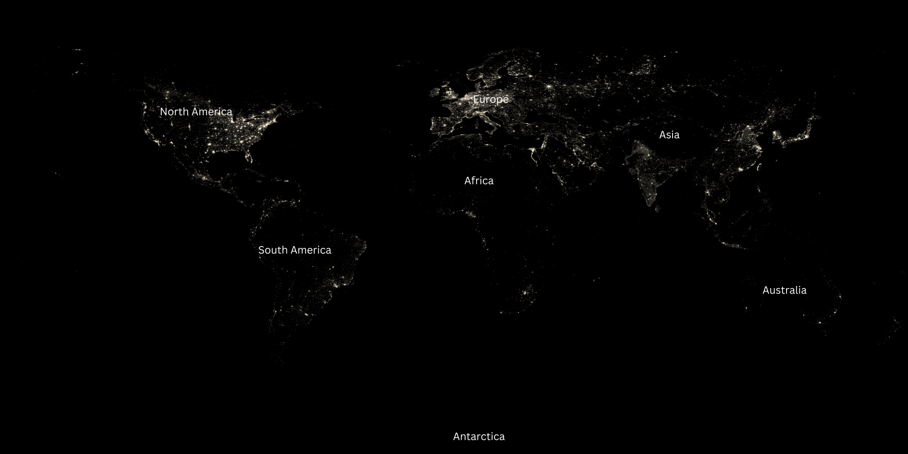
What’s going on in this image?
Notes:
Q1 – “What is going on in this image?”; after an observation is made, paraphrase and maybe follow up with Q2.
Q2 – “What do you see that makes you say that?; paraphrase again and to obtain the next observation use Q3.
Q3 – “What more can we find?”; this is an opening for another student to share an observation.

Slide 3
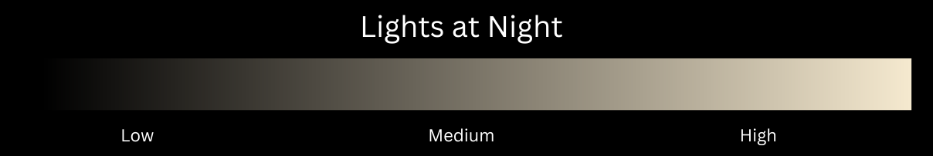
What’s going on in this image?
Notes:
Q1 – “What is going on in this image?”; after an observation is made, paraphrase and maybe follow up with Q2.
Q2 – “What do you see that makes you say that?; paraphrase again and to obtain the next observation use Q3.
Q3 – “What more can we find?”; this is an opening for another student to share an observation.

Slide 4
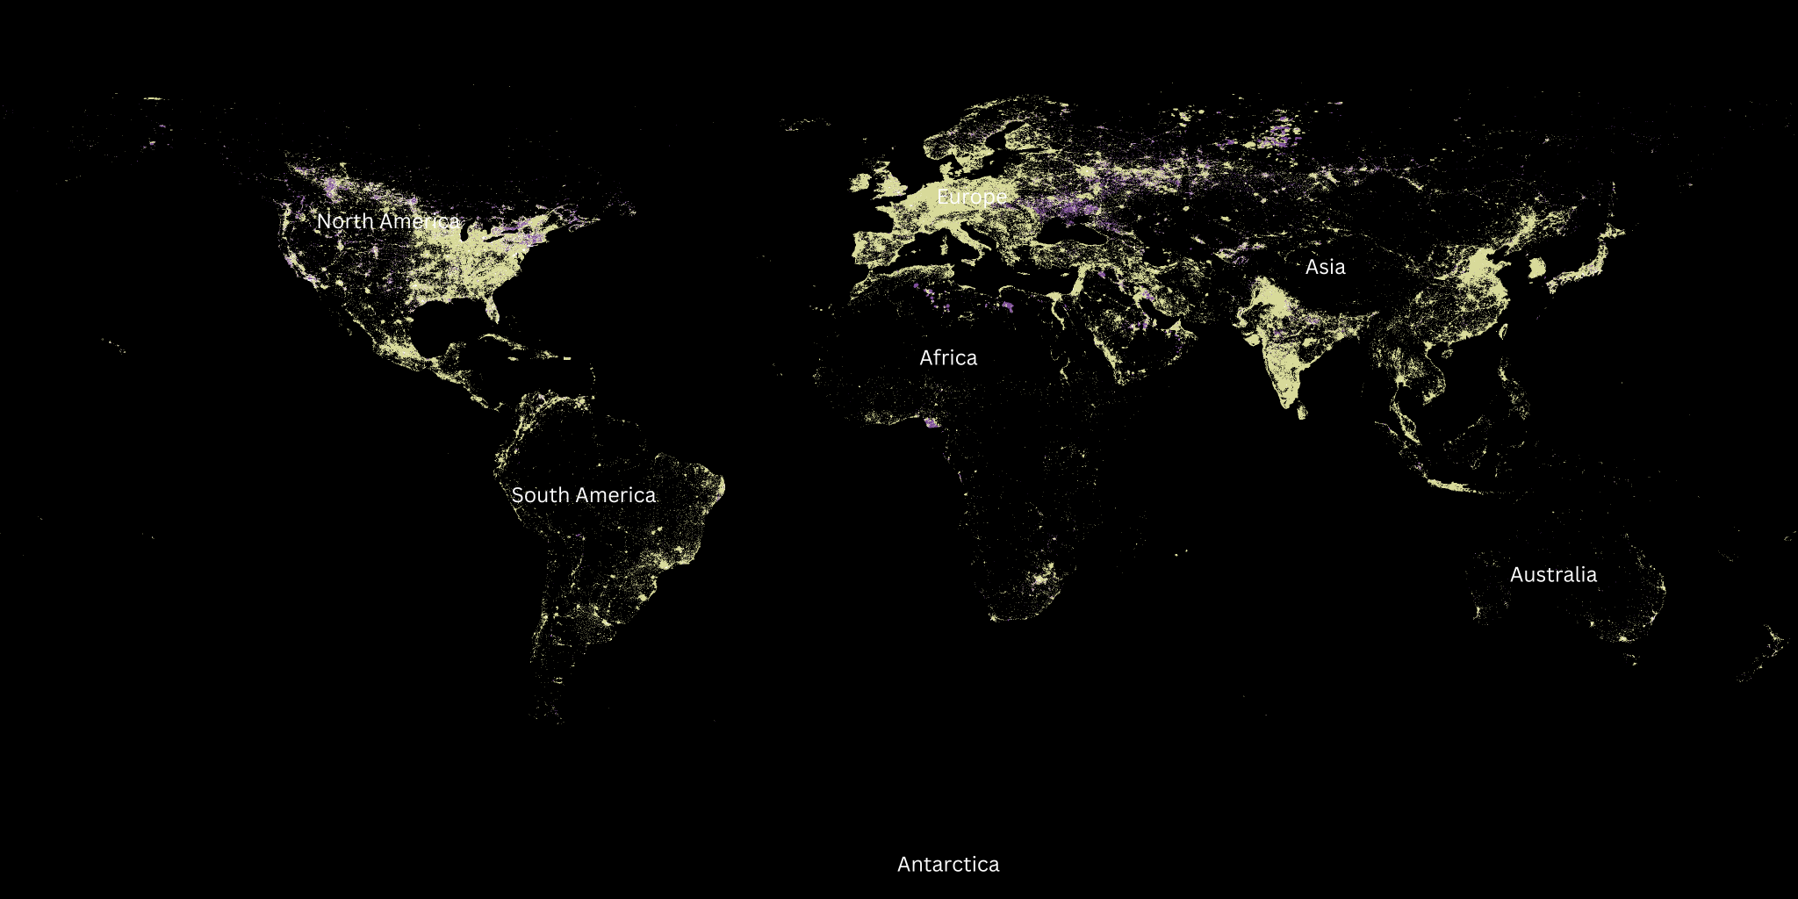
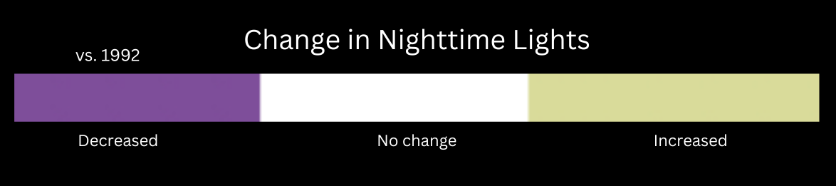
Map A:
Lights at Night 2010
What is different and what is similar about these two different maps?
Fill out the Venn diagram with your answers.
Map B:
Change in Lights at Night 2010 compared to 1992

Slide 5
Map A:
Lights at Night 2010
Using your Venn Diagram, write two questions that scientists might study based on your observations.
(on your worksheet)
Map B:
Change in Lights at Night 2010 compared to 1992

Slide 6
End of Data Lens
Want to learn more about this data from NOAA’s Science On a Sphere?
Read the dataset description on the next slide.

Slide 7
About the data: Nighttime Lights
This data comes from satellites that orbit near the North and South Poles and collect information about Earth, including how it looks at night. The satellites used special sensors to capture very dim light, like city lights, gas flares, fires, and even lightning! The data was collected by the Defense Meteorological Satellite Program (DMSP) and put together into a dataset called Nighttime Lights of the World, showing lights recorded between October 1994 and March 1995. This particular image is from 2010.
This map shows only the lights created by electricity, making it a picture of how people light up the planet. The oceans are shaded dark blue, and the land is a lighter blue so you can tell them apart. The lights appear bright white, showing where people live and how connected they are.
You can see some cool patterns! For example, many bright lights are near coastlines, because people like living near water. The Nile River in Africa is outlined by lights along its banks. In the United States, the eastern half of the country glows much brighter, showing that more people live there. You can even spot major highways by the strings of lights running along them!
This description has been edited from the one linked above to increase understanding.
Source: NOAA Science On a Sphere, NOAA View Global Data Explorer

Slide 8
Extensions - Science Literacy
Reading: Have the students partner up.
Student 1 reads “Earth at Night - Where Do Nightlights Come From?” pages 20-26
Student 2 reads “Earth at Night - Nature’s Light Shows” pages 28-32
Summarize what you learned and share with your partner.

