Slide 1
🌎 Data Lens: Exploring Earth’s Visual Stories
We are going to slow down and take ten minutes or so to observe a map and discuss what we discover and notice about it. There are no right or wrong answers!
First: Ground Rules
Raise your hand to share your ideas with the class.
All ideas are welcome.
Be respectful of others’ ideas!
It’s okay if you disagree!
Build off each others’ ideas.
Next: One minute to quietly observe…

Slide 2
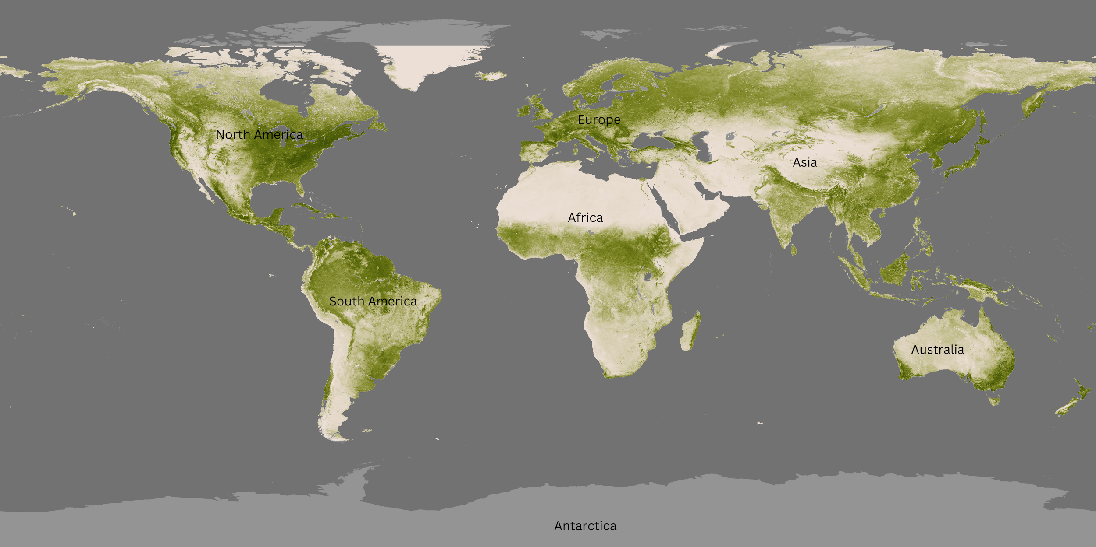
What’s going on in this image?
Notes:
Q1 – “What is going on in this image?”; after an observation is made, paraphrase and maybe follow up with Q2.
Q2 – “What do you see that makes you say that?; paraphrase again and to obtain the next observation use Q3.
Q3 – “What more can we find?”; this is an opening for another student to share an observation.

Slide 3
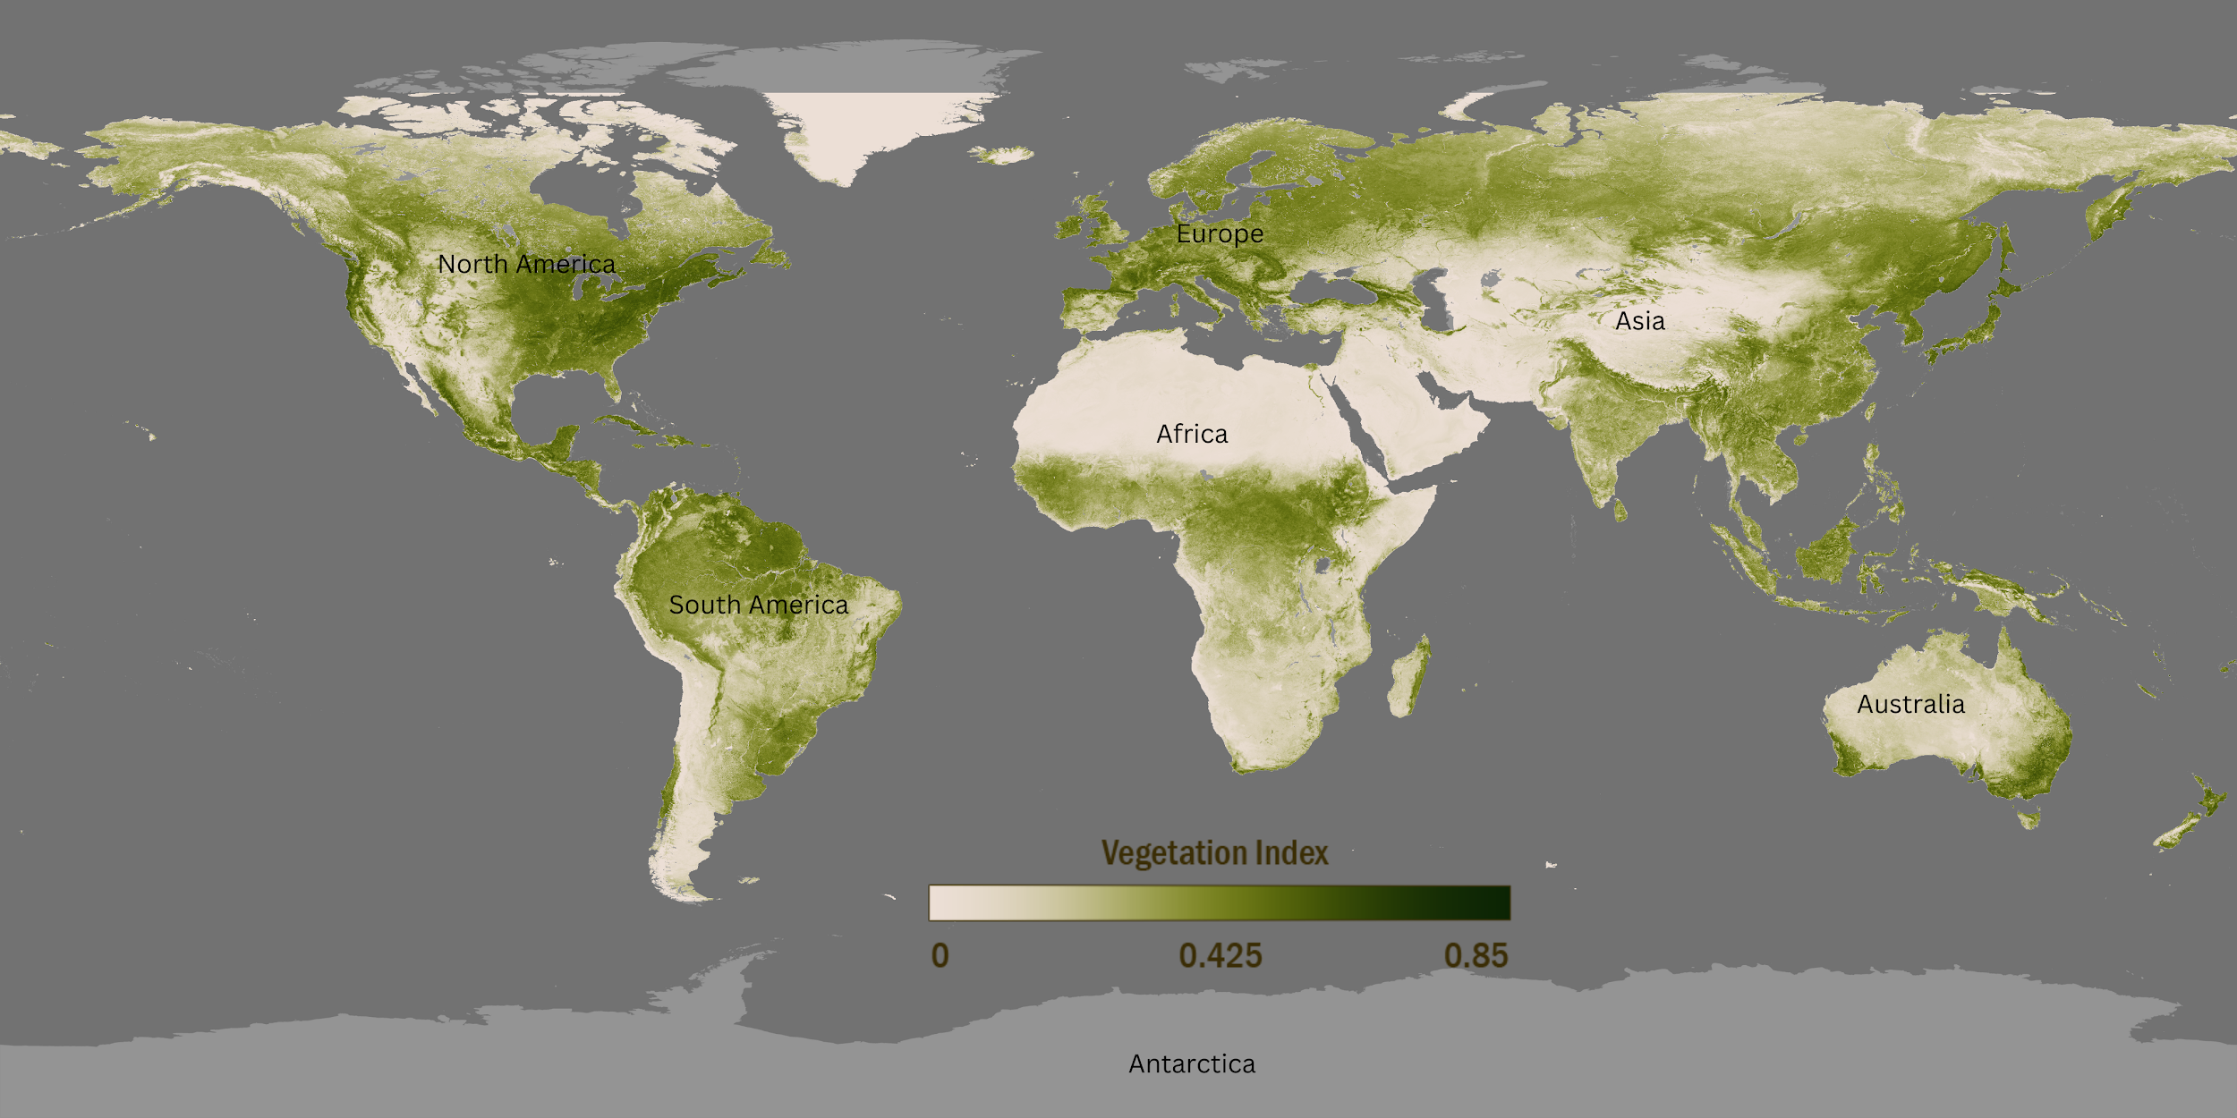
What’s going on in this image?
Notes:
Q1 – “What is going on in this image?”; after an observation is made, paraphrase and maybe follow up with Q2.
Q2 – “What do you see that makes you say that?; paraphrase again and to obtain the next observation use Q3.
Q3 – “What more can we find?”; this is an opening for another student to share an observation.

Slide 4
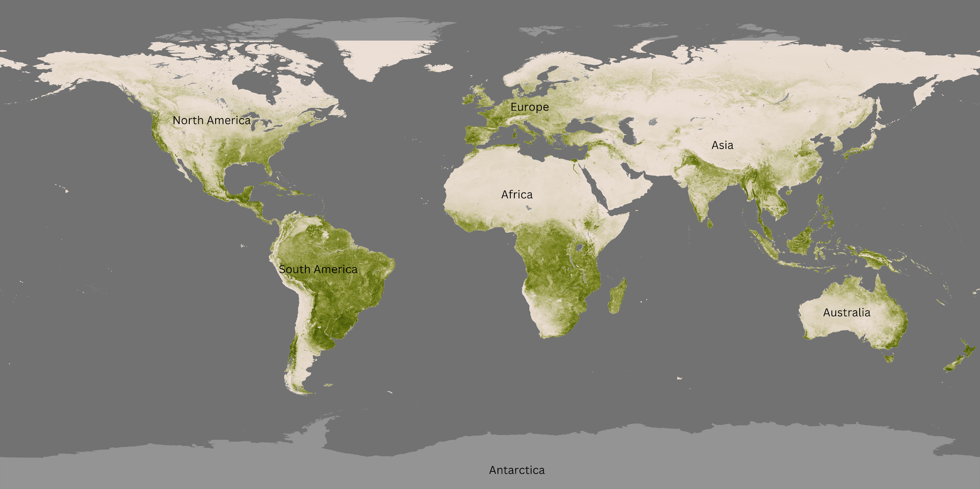
Map A:
March 2024
What is different and what is similar about these two different time periods of the same mapped data?
Fill out the Venn diagram with your answers.
Map B:
September 2024

Slide 5
Using your Venn Diagram, write two questions that scientists might study based on your observations.
(on your worksheet)

Slide 6
End of Data Lens
Want to learn more about this data from NOAA’s Science On a Sphere?
Read the dataset description on the next slide.

Slide 7
About the data: Vegetation
Earth’s surface is mostly covered in water, but the land—about 25% of it—is full of green, living things that change over time. The NOAA-20 satellite, which circles the Earth near the North and South Poles, helps scientists watch these changes in greenness using a special instrument called the Visible-Infrared Imager/Radiometer Suite (VIIRS). This tool allows NOAA scientists to create highly detailed pictures of plants and vegetation on our planet.
In these images, dark green areas show the lushest spots, where plants are thick and soak up a lot of sunlight. Lighter colors show places with less plant life, such as snowy, dry, rocky, or city areas. VIIRS picks up changes in how much visible light is reflected by the plants, which helps scientists see changes in vegetation over time.
Each week, NOAA-20 captures a new image of Earth’s vegetation. This creates a year-long animation that shows how plants have changed across seasons and regions. The images from VIIRS are clearer and have more detail than older satellite images, letting us see changes in plants with great accuracy. This information is important for weather forecasts, environmental studies, and the U.S. Drought Monitor. Many organizations use NOAA’s vegetation data, including the U.S. Department of Agriculture and the U.S. Geological Survey, to monitor crops and predict food supplies.
The data seen in this exercise is monthly averages for March and September of 2024.
This description has been edited from the one linked above to increase understanding.
Source: NOAA Science On a Sphere, NOAA View Global Data Explorer

Slide 8
Extensions
Reading: Read about the changing seasons NOAA Education or Astronomical vs. Meteorological Seasons and parse out the main ideas to share with a partner.
Activity/Experiment - Can crickets tell the temperature? The answer is in their chirp! NOAA Education activity.

