Slide 1
🌎 Data Lens: Exploring Earth’s Visual Stories
We are going to slow down and take ten minutes or so to just observe and discuss what we discover and notice. There are no right or wrong answers.
First: Ground Rules
Raise your hand to share your ideas with the class.
All ideas are welcome.
Be respectful of others’ ideas. It’s okay to disagree.
Build on each other’s ideas.
Next: One minute to quietly observe…

Slide 2
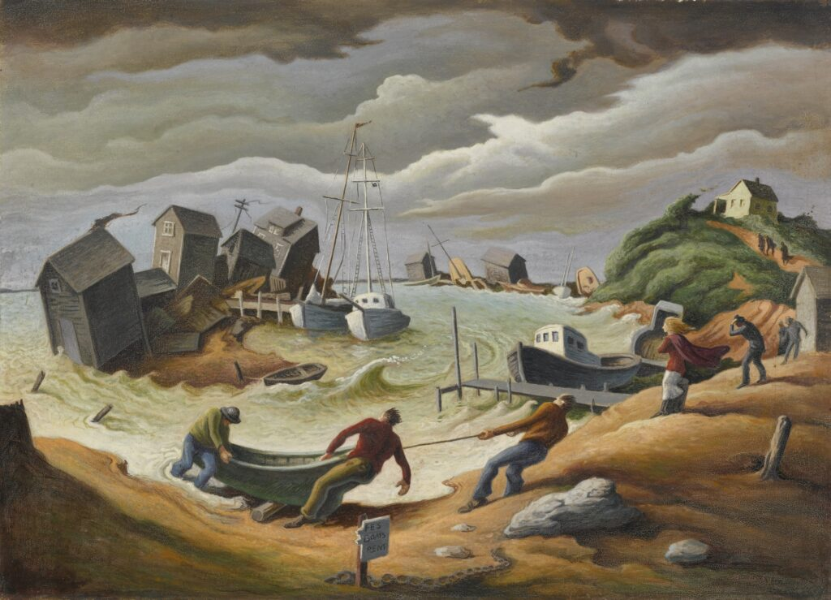
What’s going on here?
Notes:
Q1 – “What is going on in this image?”; after an observation is made, paraphrase and maybe follow up with Q2.
Q2 – “What do you see that makes you say that?; paraphrase again and to obtain the next observation use Q3.
Q3 – “What more can we find?”; this is an opening for another student to share an observation.
Photo Credit: German Portillo

Slide 3
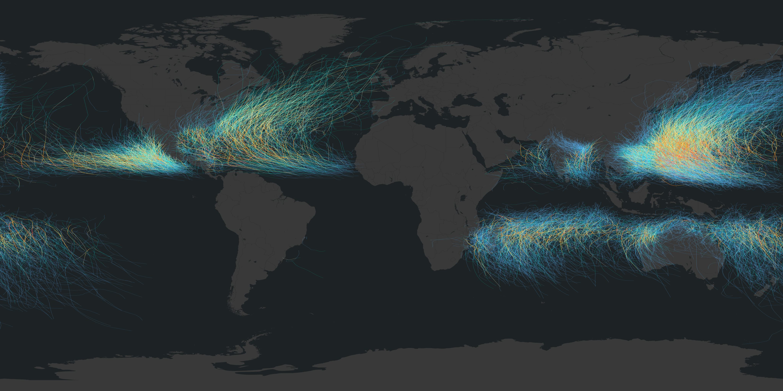
What’s going on here?
Notes:
Q1 – “What is going on in this image?”; after an observation is made, paraphrase and maybe follow up with Q2.
Q2 – “What do you see that makes you say that?; paraphrase again and to obtain the next observation use Q3.
Q3 – “What more can we find?”; this is an opening for another student to share an observation.

Slide 4
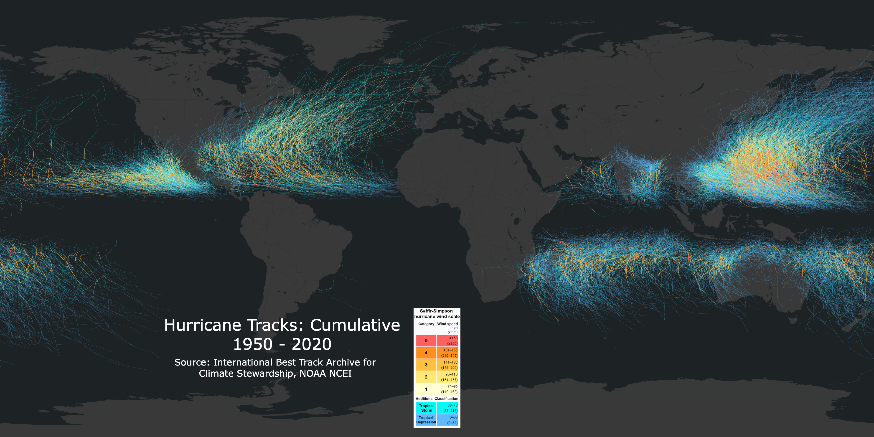
Now, what do you notice?
Notes:
Q1 – “What is going on in this image?”; after an observation is made, paraphrase and maybe follow up with Q2.
Q2 – “What do you see that makes you say that?; paraphrase again and to obtain the next observation use Q3.
Q3 – “What more can we find?”; this is an opening for another student to share an observation.

Slide 5
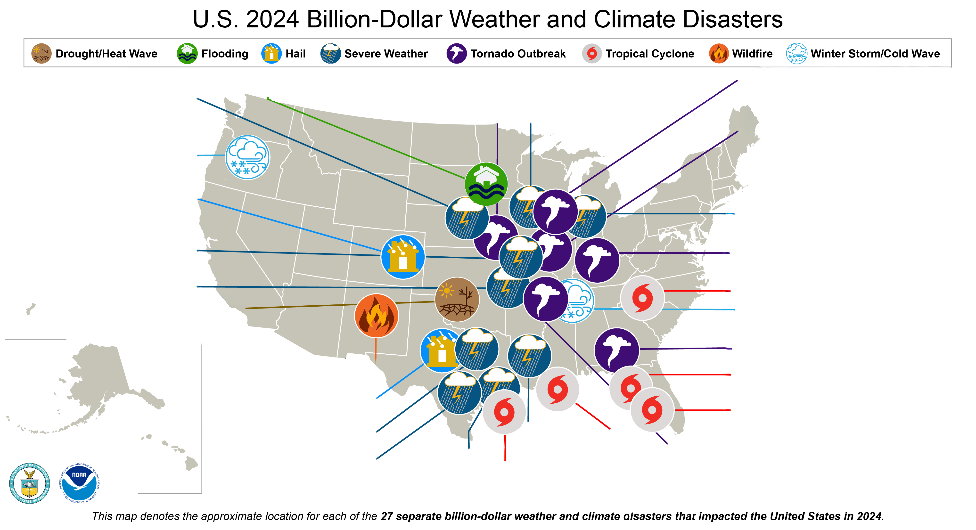
Questions
Answer on your worksheet:
Take a deep look at the U.S. 2024 Billion-Dollar Weather and Climate Disasters in pairs.
What are three sentences you could say about the map and/or your opinions or ideas about it?
Source: NOAA National Centers for Environmental Information

Slide 6
End of Data Lens
Learn more about the dataset and artwork. Read the descriptions on the next slides. (5 min)
Go to the last slide, watch a Hurricane Hunter video and answer a couple of questions. (5 min)

Slide 7
Hurricane Tracks
Tracking historical hurricanes is an important way for hurricane researchers to learn about the paths of future hurricanes. Because of this, records of hurricane paths are archived and studied. Not all hurricanes follow the same path, but there are certainly noticeable trends for hurricane paths. Many computer models that have been created to predict hurricane paths include the historical data in their models.
This dataset shows the paths of all tropical cyclones from 1950 through 2020. Each line is a tropical cyclone, whether a tropical depression or tropical storm (blue, cyan) or hurricane (yellow to red). The maximum sustained wind speed, with cool colors for slower speeds and warm colors for faster speeds, are indicated by the colorbar. When mapped like this, definite patterns in cyclone paths are clear to see. For example, you can see that cyclones typically start near the equator and move away from it toward the poles and they don't cross the equator.

Slide 8
The Menemsha Hurricane
Artist: Thomas Hart Benton
Year: 1954
Topic Keyword(s): Hurricane
Description: Martha’s Vineyard was hit by two hurricanes in 1954. The first was Hurricane Carol, which hit without warning on August 30th with winds that gusted to 90 miles-an-hour, causing extraordinary devastation, and leaving Dutcher Dock in Menemsha piled high with the wreckage of yachts and fishing boats. The second was Hurricane Edna, which hit ten days later, on September 11, with winds that gusted to 110 miles-an-hour, but which did less damage than Carol since this time there was ample warning that the storm was coming and it hit at low tide.

Slide 9
Career video extension
Intended for: 6-12 Grade (15-20 minutes)
View as a class or individually – NOAA Hurricane Hunters (2:30)
Answer a few questions on your worksheet.
What do you think about the career described in this video? What would you like to ask them?

