Slide 1
🌎 Data Lens: Exploring Earth’s Visual Stories
We are going to slow down and take ten minutes or so to observe a map and discuss what we discover and notice about it. There are no right or wrong answers!
First: Ground Rules
Raise your hand to share your ideas with the class.
All ideas are welcome.
Be respectful of others’ ideas!
It’s okay if you disagree!
Build off each others’ ideas.
Next: One minute to quietly observe…

Slide 2
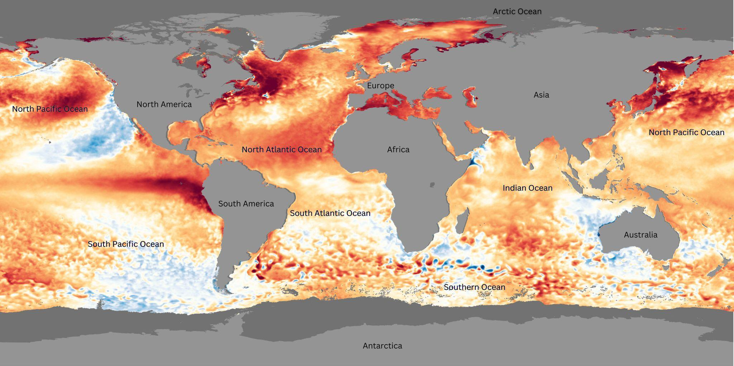
What’s going on in this image?
Notes:
Q1 – “What is going on in this image?”; after an observation is made, paraphrase and maybe follow up with Q2.
Q2 – “What do you see that makes you say that?; paraphrase again and to obtain the next observation use Q3.
Q3 – “What more can we find?”; this is an opening for another student to share an observation.

Slide 3
What’s going on in this image?
Notes:
Q1 – “What is going on in this image?”; after an observation is made, paraphrase and maybe follow up with Q2.
Q2 – “What do you see that makes you say that?; paraphrase again and to obtain the next observation use Q3.
Q3 – “What more can we find?”; this is an opening for another student to share an observation.

Slide 4
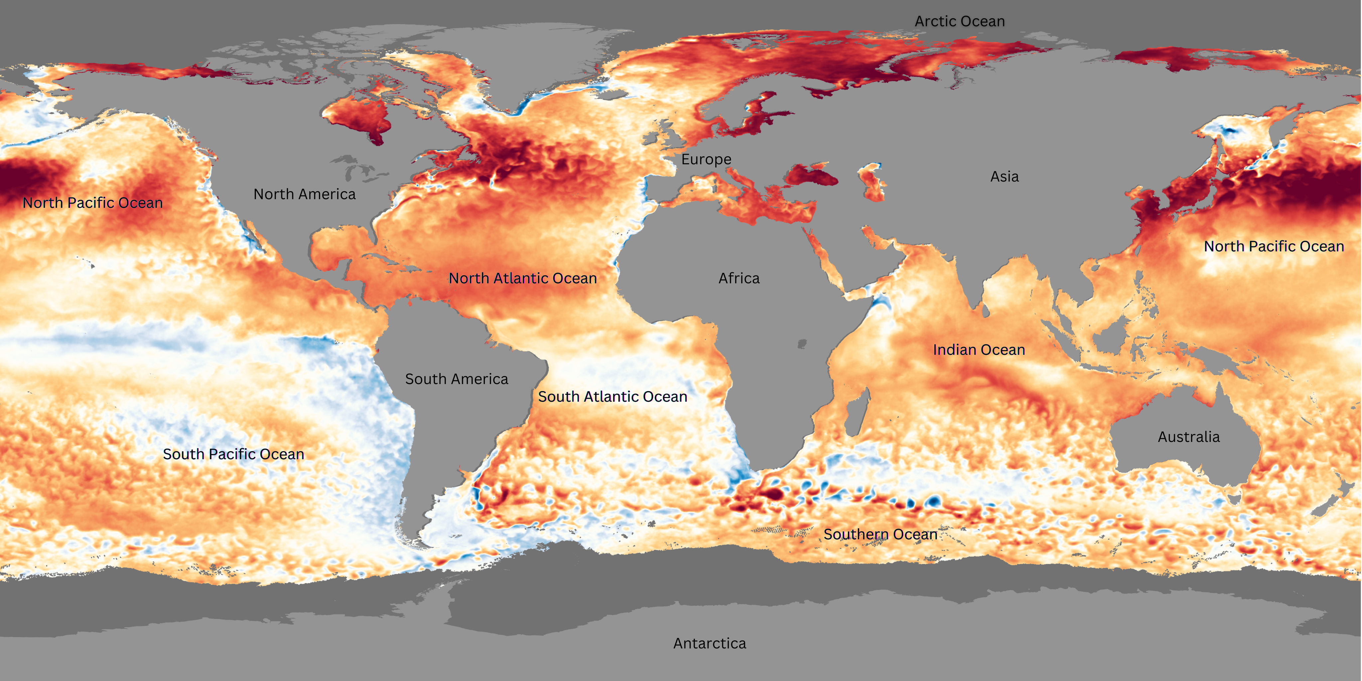
Map A:
August 2023
What is different and what is similar about these two different time periods of the same mapped data?
Fill out the Venn diagram with your answers.
Map B:
September 2024

Slide 5
Using your Venn Diagram, write two questions that scientists might study based on your observations.
(on your worksheet)

Slide 6
End of Data Lens
Want to learn more about sea surface temperature anomaly (SSTA) data from NOAA’s Science On a Sphere?
Read the dataset description on the next slide.

Slide 7
About the data: Sea Surface Temperature Anomaly
This real-time sea surface temperature data comes from NOAA's Coral Reef Watch. It helps scientists monitor coral reefs by tracking changes in ocean temperature, which can lead to coral bleaching. The data is collected by satellites from the U.S. and other countries like Japan and Europe.
To understand the ocean's temperature, scientists compare today’s sea surface temperature with the long-term average temperature for that day. The difference between these two temperatures is called a “sea surface temperature anomaly.”
This data is very detailed, with each pixel showing about 5 kilometers of the ocean. You can see big patterns like El Niño and La Niña - which happen in the Pacific Ocean near Peru in South America - but also smaller events like hurricanes.
Just like the air around us, the ocean’s temperature is always changing. However, water takes longer to heat up and cool down than air, so the ocean doesn’t change as much day-to-day. But you can see seasonal changes, like how warm water spreads toward the U.S. in summer and pulls back in winter.
Scientists study these temperature changes because they are important for understanding things like coral reef health, hurricanes, and global weather patterns like El Niño and La Niña.
Source: NOAA Science On a Sphere

Slide 8
Extensions
Student-led activities
Reading: Read about the El Nino patterns on Climate.gov or National Ocean Service and parse out the main ideas.
Digital Activity: Students can complete NOAA Data in the Classroom El Nino module using any device connected to the Internet.

